Slide 1
TWO-PORT CIRCUITS

Slide 2
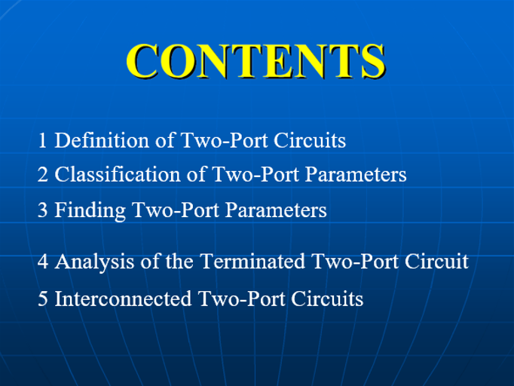

Slide 3
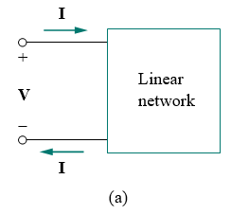
INTRODUCTION
A pair of terminals through which a current may enter or leave a network is known as a port. Two-terminal devices or elements (such as resistors, capacitors, and inductors) result in one-port networks.
Most of the circuits we have dealt with so far are two-terminal or one-port circuits, represented in Fig.1(a). We have considered the voltage across or current through a single pair of terminals—such as the two terminals of a resistor, a capacitor, or an inductor.

Slide 4
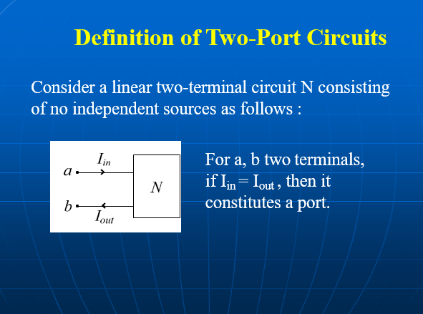

Slide 5
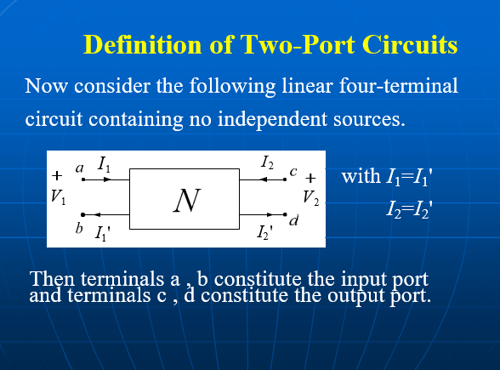

Slide 6
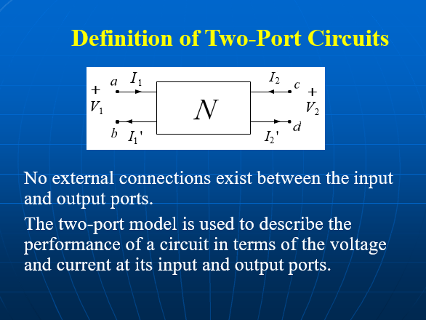

Slide 7
A two-port network (four-terminals network ) is an electrical network (circuit) or device with two pairs of terminals to connect to external circuits.
Two terminals constitute a port if the currents applied to them satisfy the port condition:
the electric current entering one terminal must equal to the current emerging from the other terminal on the same port.
The ports constitute interfaces where:
the network connects to other networks,
the points where signals are applied or outputs are taken.
In a two-port network, often port 1 is considered the input port and port 2 is considered the output port.

Slide 8
The two-port network model is used in mathematical circuit analysis techniques to isolate portions of larger circuits.
A two-port network is regarded as a "black box" with its properties specified by a matrix of numbers.
Advantages;
The response of the network to signals applied to the ports
`can be calculated easily, without solving for all the internal voltages and currents in the network.
It also allows similar circuits or devices to be compared easily.
Any linear circuit with four terminals can be regarded as a two-port network provided that it does not contain an independent source and satisfies the port conditions.

Slide 9
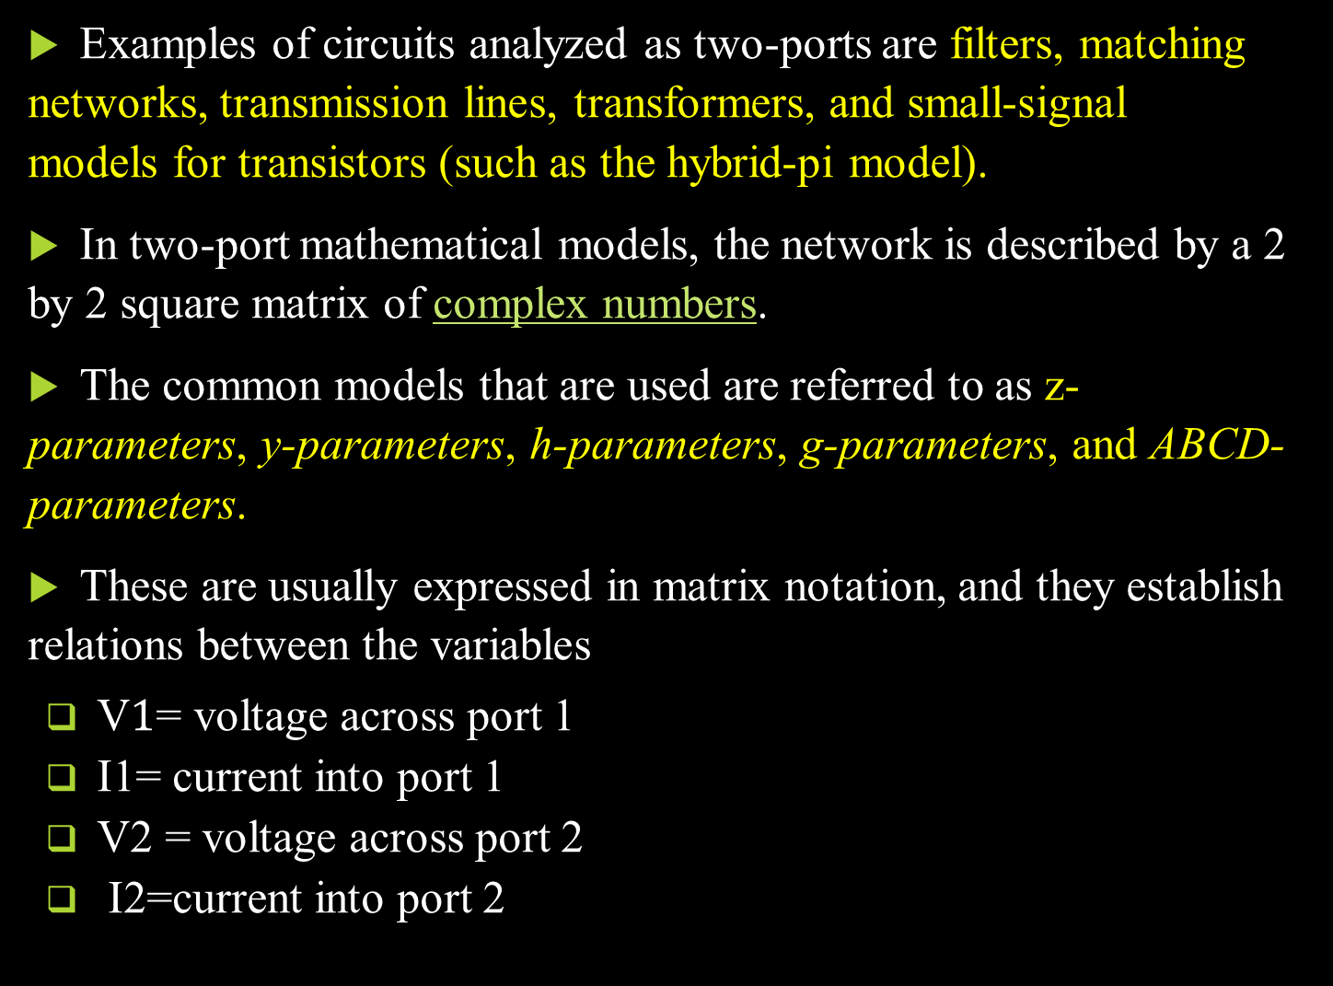
Examples of circuits analyzed as two-ports are filters, matching networks, transmission lines, transformers, and small-signal models for transistors (such as the hybrid-pi model).
In two-port mathematical models, the network is described by a 2 by 2 square matrix of complex numbers.
The common models that are used are referred to as z-parameters, y-parameters, h-parameters, g-parameters, and ABCD-parameters.
These are usually expressed in matrix notation, and they establish relations between the variables
V$1$= voltage across port 1
I1= current into port 1
V2 = voltage across port 2
I2=current into port 2

Slide 10
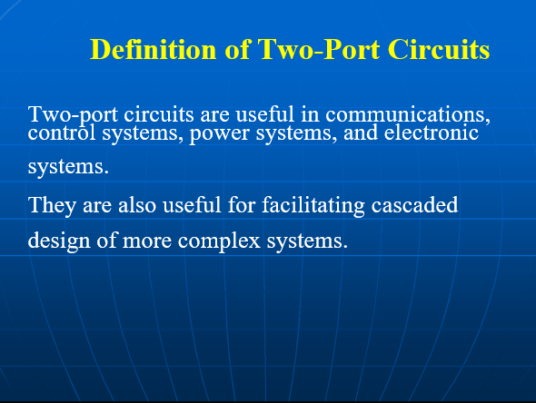

Slide 11
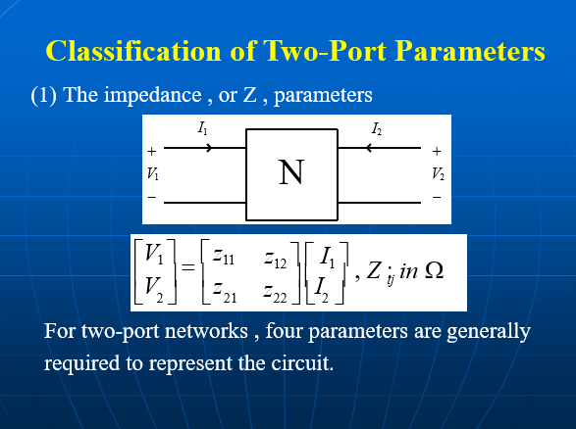

Slide 12
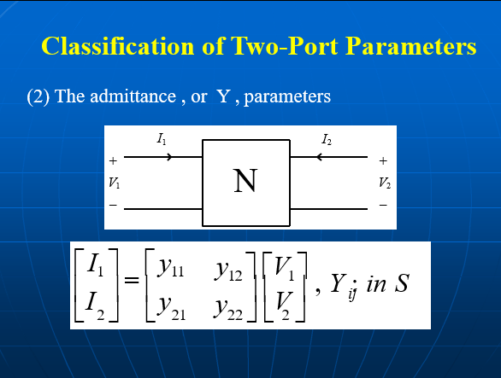

Slide 13
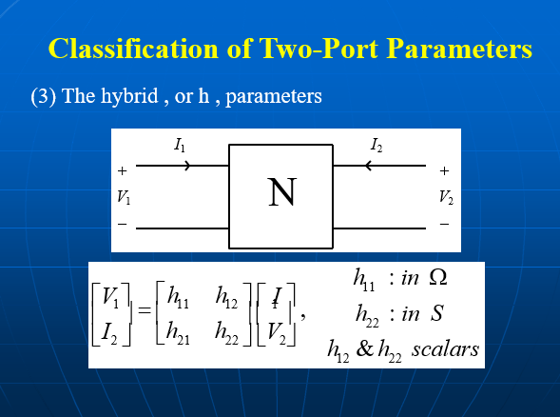

Slide 14
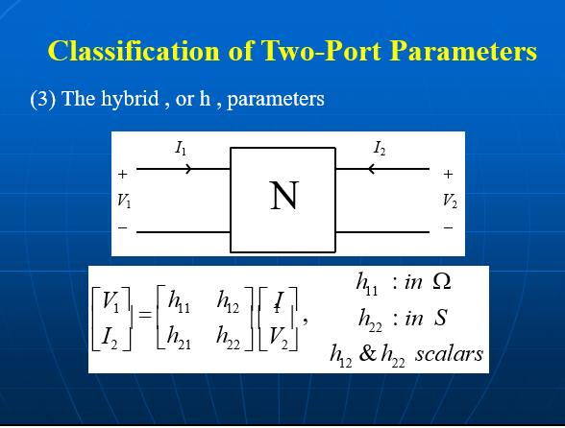

Slide 15
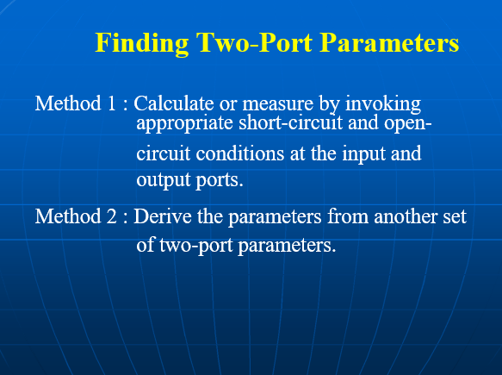

Slide 16
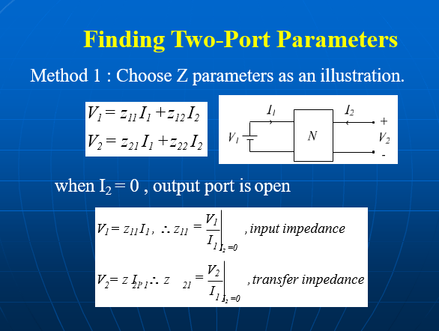

Slide 17
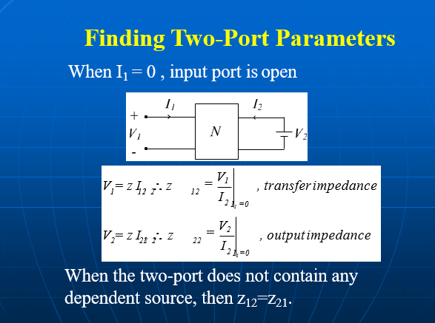

Slide 18
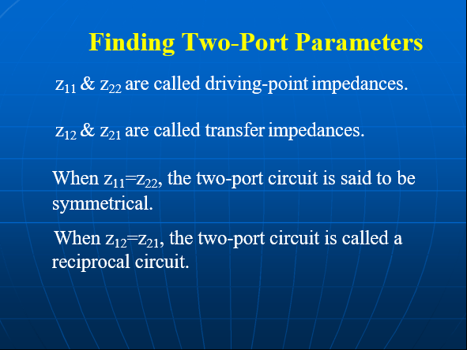

Slide 19
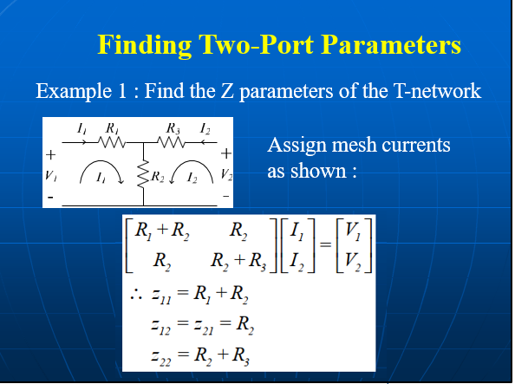

Slide 20
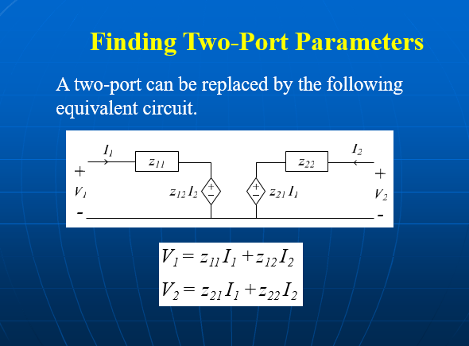

Slide 21
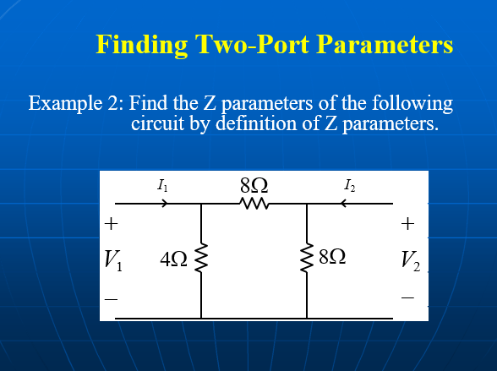

Slide 22
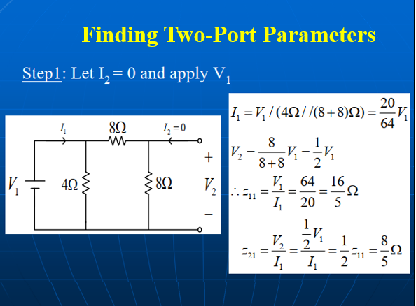

Slide 23
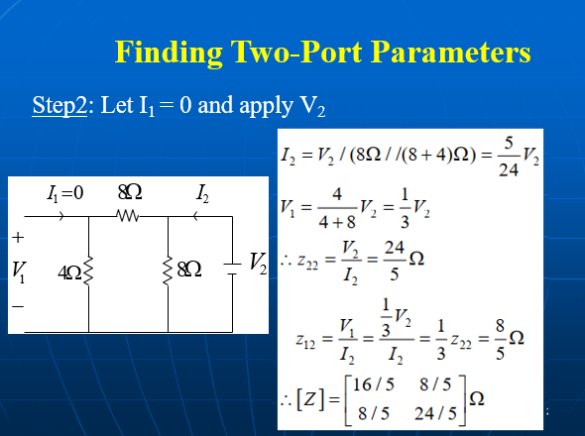

Slide 24
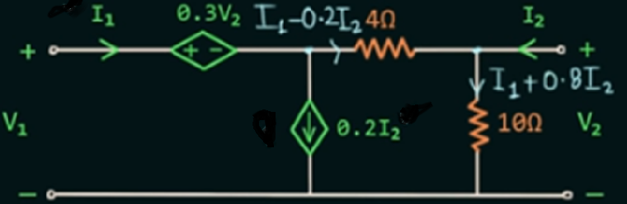
Detemine the Z parameter matrix of the port networks below

Slide 25

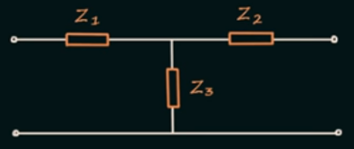

Slide 26
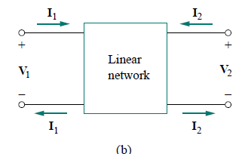
We have also studied four-terminal or two-port circuits involving op amps, transistors, and transformers, as shown in Fig.b
In general, a network may have n ports.
A port is an access to the network and consists of a pair of terminals; the current entering one terminal leaves through the other terminal so that the net current entering the port equals zero.

Slide 27
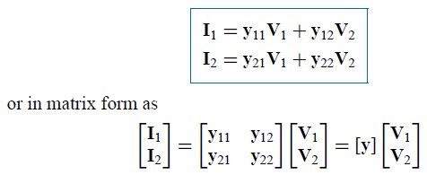
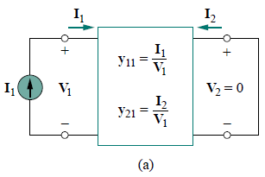
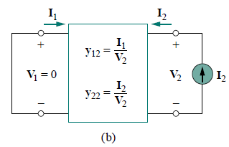
ADMITTANCE PARAMETERS
Admittance parameters are obtained by expressing the terminal currents in terms of the terminal voltages
In either Fig. (a) or (b), the terminal currents can be expressed in terms of the terminal voltages as

Slide 28
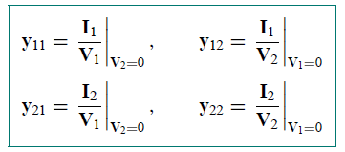
The y terms are known as the admittance parameters (or, simply, y pa- rameters) and have units of siemens.
The values of the parameters can be determined by setting V1 = 0 I2 (input port short-circuited) or V2 = 0 (output port short-circuited). Thus
Since the y parameters are obtained by short-circuiting the input or out- put port, they are also called the short-circuit admittance parameters. Specifically,
y11 = Short-circuit input admittance
y12 = Short-circuit transfer admittance from port 2 to port 1
y21 = Short-circuit transfer admittance from port 1 to port 2
y22 = Short-circuit output admittance

Slide 29


y11 and y21 are obtained by connecting a current I1 to port 1 and short-circuiting port 2 as in Fig. (a), finding V1 and I2, and then calculating
Similarly, y12 and y22 are obtained by connecting a current source I2 to port 2 and short-circuiting port 1 as in Fig. (b), finding I1 and V2, and then getting
This procedure provides us with a means of calculating or measuring the y parameters.
The impedance and admittance parameters are collectively referred to as immittance parameters

Slide 30
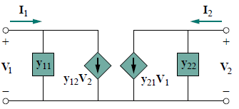
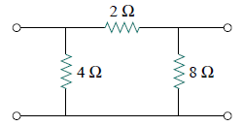
The general equivalent circuit for y parameters
Examples
Obtain the y parameters for the П network shown in figure

Slide 31
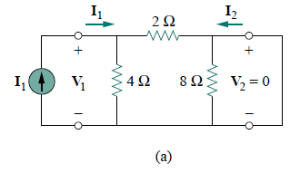
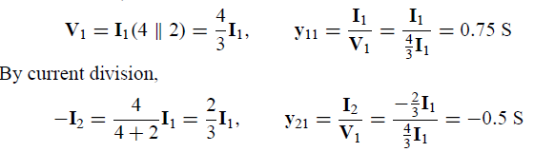
Solution
To find y11 and y21, short-circuit the output port and connect a current source I1 to the input port as in Fig.(a)

Slide 32
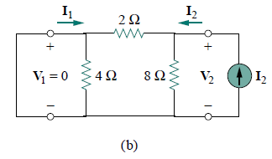
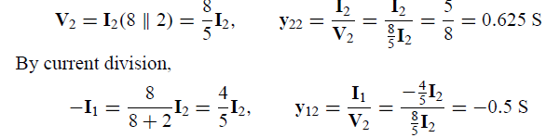
To get y12 and y22, short-circuit the input port and connect a current source I2 to the output port as in Fig.(b).

Slide 33
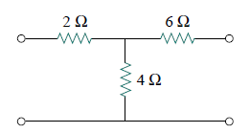
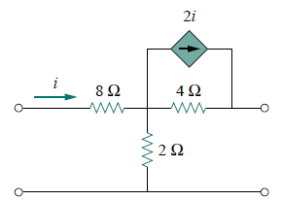
2. Obtain the y parameters for the T network shown in Fig.
3. Determine the y parameters for the two-port shown in Fig.

Slide 34
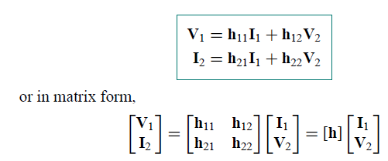
HYBRID PARAMETERS
The z and y parameters of a two-port network do not always exist. So there is a need for developing another set of parameters.
This third set of parameters is based on making V1 and I2 the dependent variables. Thus, we obtain

Slide 35
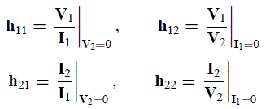
The h terms are known as the hybrid parameters (or, simply, h parameters) because they are a hybrid combination of ratios.
They are very useful for describing electronic devices such as transistors; it is much easier to measure experimentally the h parameters of such devices than to measure their z or y parameters.
The values of the parameters are determined as

Slide 36
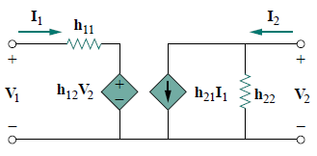
It is evident that the parameters h11, h12, h21, and h22 represent an impedance, a voltage gain, a current gain, and an admittance, respectively. This is why they are called the hybrid parameters.
To be specific,
h11 = Short-circuit input impedance
h12 = Open-circuit reverse voltage gain
h21 = Short-circuit forward current gain
h22 = Open-circuit output admittance
The h-parameter equivalent network

Slide 37
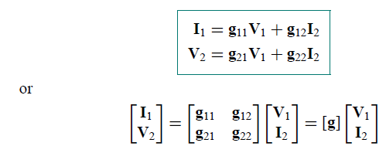
The procedure for calculating the h parameters is similar to that used for the z or y parameters.
Voltage or current source is applied to the appropriate port, short-circuit or open-circuit the other port, depending on the parameter of interest, and perform regular circuit analysis.
For reciprocal networks, h12 = -h21.
Note;
A set of parameters closely related to the h parameters are the g-parameters or inverse hybrid parameters.
These are used to describe the terminal currents and voltages as

Slide 38
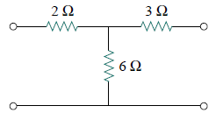
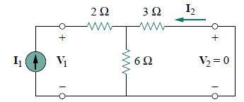
Examples
Find the hybrid parameters for the two-port network of Fig.
Solution
To find h11 and h21, short-circuit the output port and connect a current source I1 to the input port as shown in Fig.

Slide 39
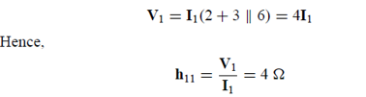
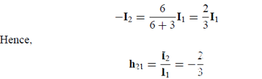
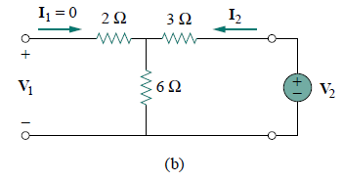
To obtain h12 and h22, we open-circuit the input port and connect a voltage source V2 to the output port as in Fig.(b).

Slide 40
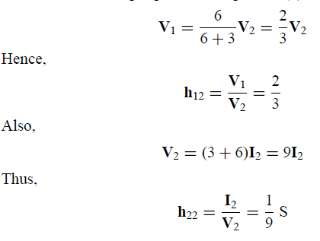
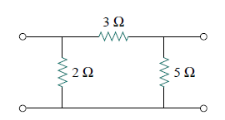
By voltage division
2. Determine the h parameters for the circuit in Fig.

